Slide 1
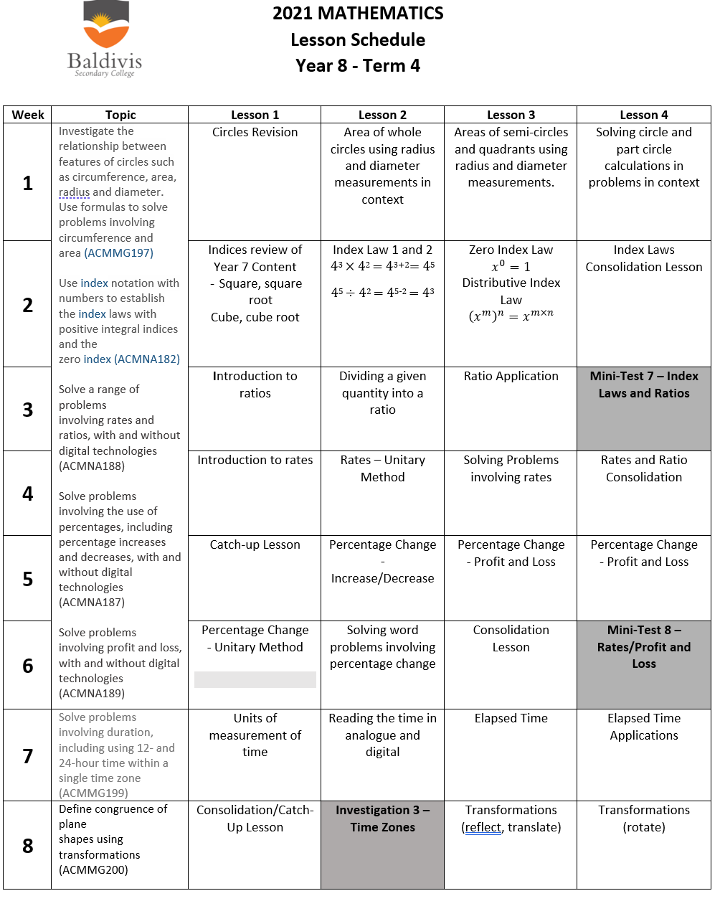
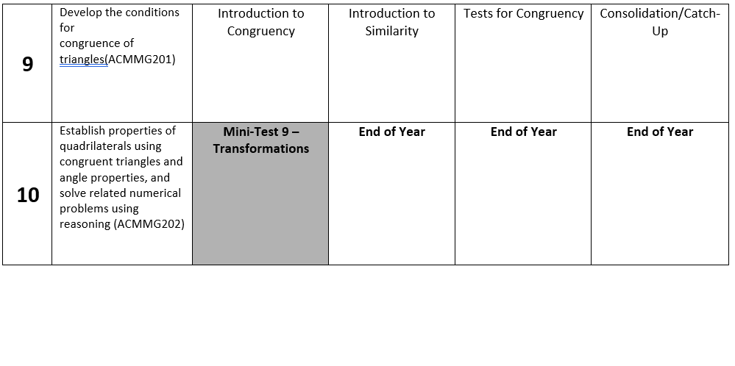
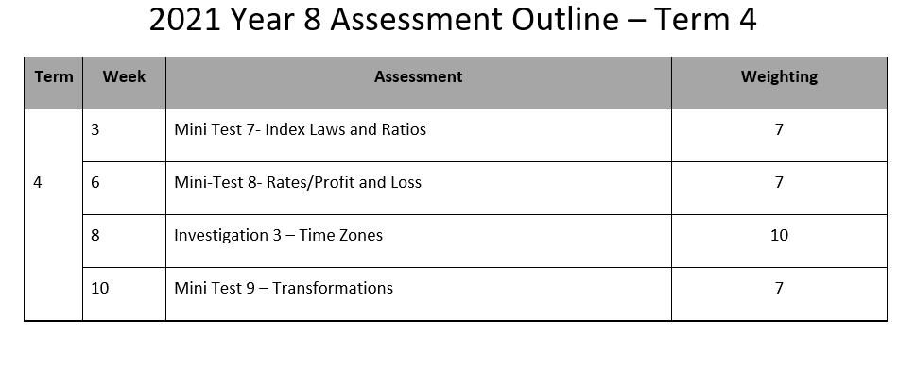

Slide 2
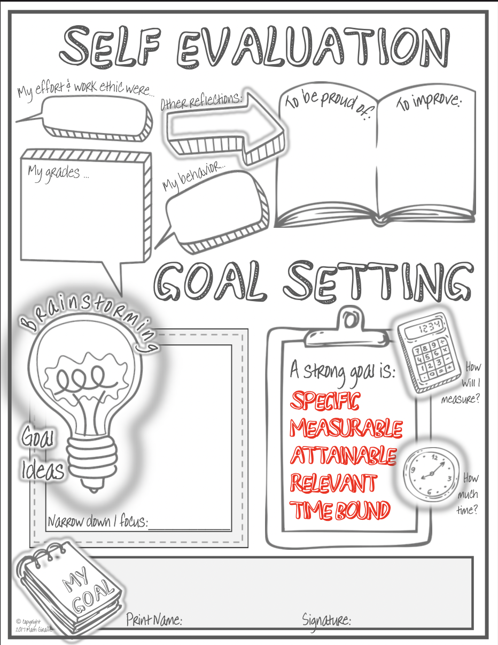
Complete the My Goals worksheet and glue into the front or back or your exercise book.

Slide 3

Topic: Circles EQ: What do I remember about circles?
circles

Slide 4
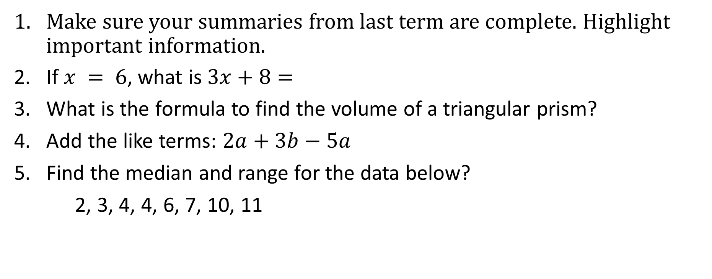
Have a go at these questions:
Topic: Circles EQ: What do I remember about circles?
Make sure your summaries from last term are complete. Highlight important information.
If $x = 6$, what is $3x+8=$
What is the formula to find the volume of a triangular prism?
Add the like terms: $2a+3b−5a$
Find the median and range for the data below?
2, 3, 4, 4, 6, 7, 10, 11

Slide 5
Brainstorm: What do you remember about circles?
circles

Slide 6
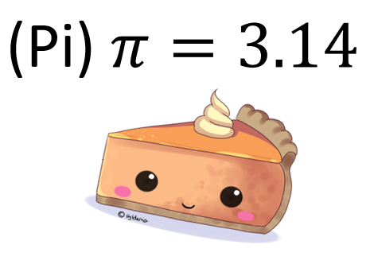

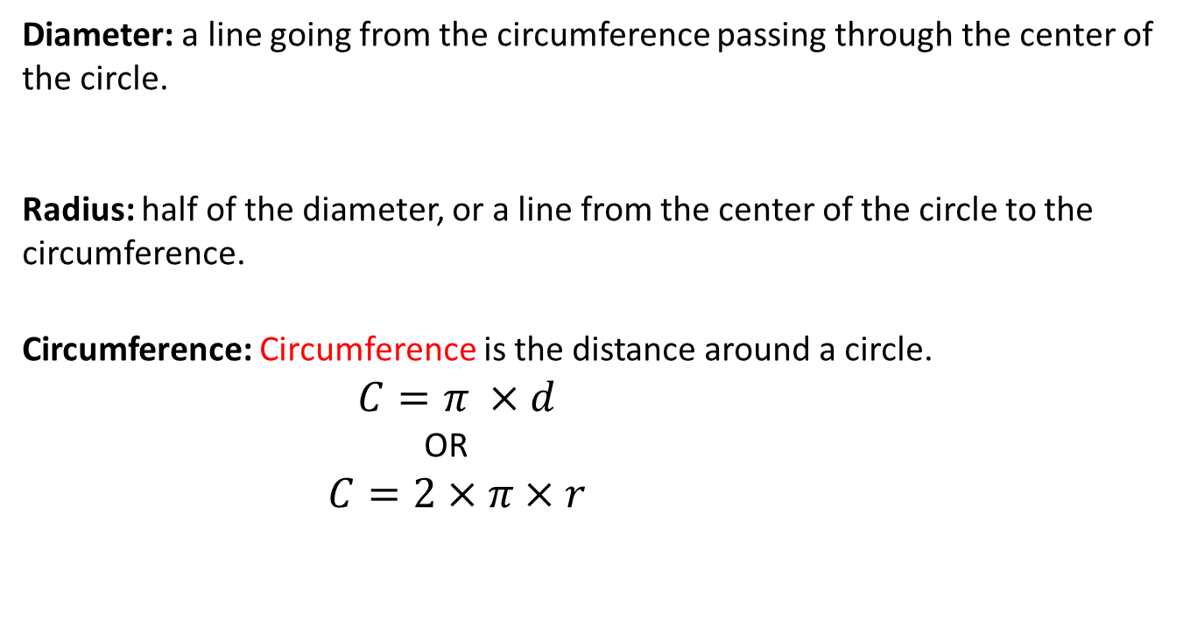
Topic: Circles EQ: What do I remember about circles?
What is the diameter and radius?
How do I calculate circumference?
Diameter: a line going from the circumference passing through the center of the circle.
Radius: half of the diameter, or a line from the center of the circle to the circumference.
Circumference: Circumference is the distance around a circle.
$$C=π ×d$$
OR
$$C=2×π×r$$
d
r
How do I find the area of a circle?
Area
To find the area of a circle I use the formula:
$$A=π×r^{2}$$

Slide 7


Slide 8
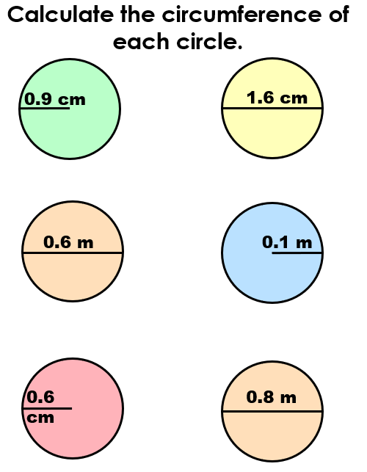
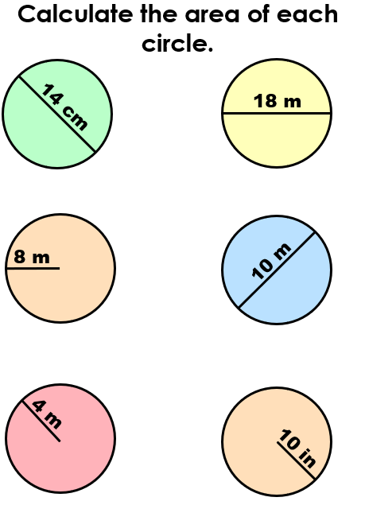
4. 7. 10.
2. 5. 8. 11.
3. 6. 9. 12.

Slide 9
What Questions
do you have??

